Slide 1

Blogger Boost: Know Yourself and Your Community
Elena Dubova @Metis
June 2020

Slide 2
01
TABLE OF CONTENTS
02
03
04
BUSINESS CASE & DATA
TOPICAL EMBBEDDINGS
EMOTIONS OVER TIME
WEB APPLICATION

Slide 3
01
BUSINESS CASE & DATA

Slide 4
—ERIK ERIKSON
“In the social jungle of human existence, there is no feeling of being alive without a sense of identity.”
Notes:
GERMAN-AMERICAN developmental psychologist

Slide 5
BUSINESS CASE
internet adds uncertainty and increase risks of social interaction:
It is hard to get a feedback and self-reflect than taking to a life audience;
It is hard to understand your place in the community and connect to people like you
DATA
Blog Authorship Corpus
source: blogger.com
format: XML
size: 19K+ bloggers; 300K+ posts, 78M+ words
balanced demographics: gender, age

Slide 6
Final Product
SELF-AWARENESS DASHBOARD
COMMUNITY VISUALIZER
identifies a blogger to a community map based on the topics of their blog
shows 8 prime emotions fluctuations over blogging history

Slide 7
02
TOPICAL EMBEDDINGS

Slide 8
TOPICS*
﻿Days of My Life
go
day
night
home
time
work
Teen Spirit
lol
school
fun
kinda
cool
stuff
Relationships
know
love
want
feel
people
friends
Slang People
lor
wad
cos
noe
ppl
dunno
Politics
bush
kerry
iraq
war
president
people
Faith
god
church
jesus
life
lord
christ
Leisure
blog
people
new
book
game
music
*algorithm: TF-IDF NMF

Slide 9
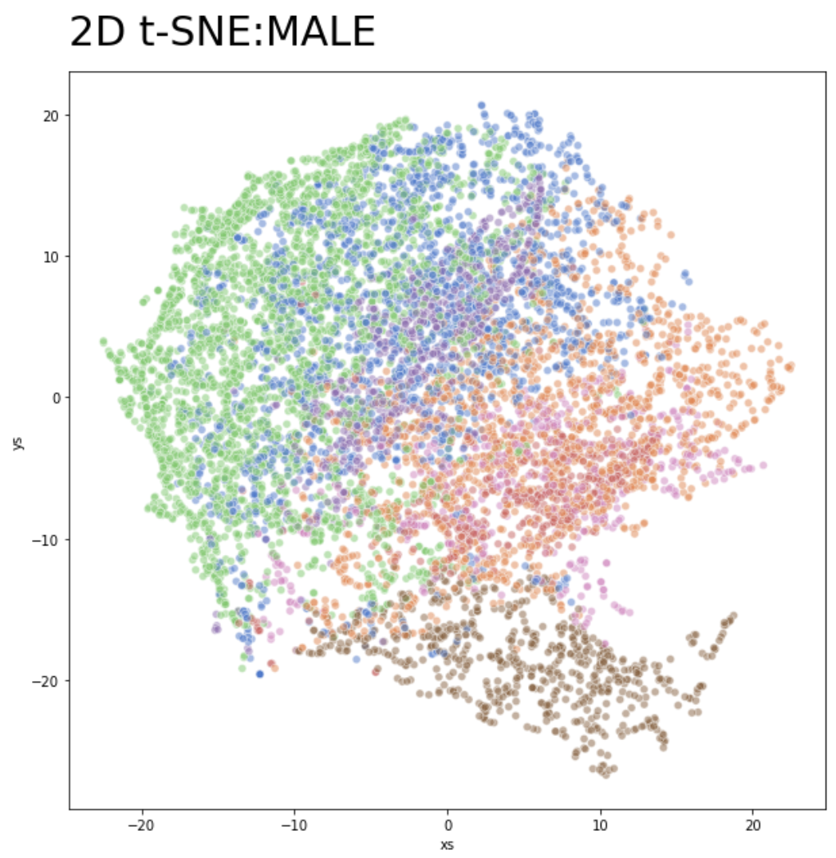
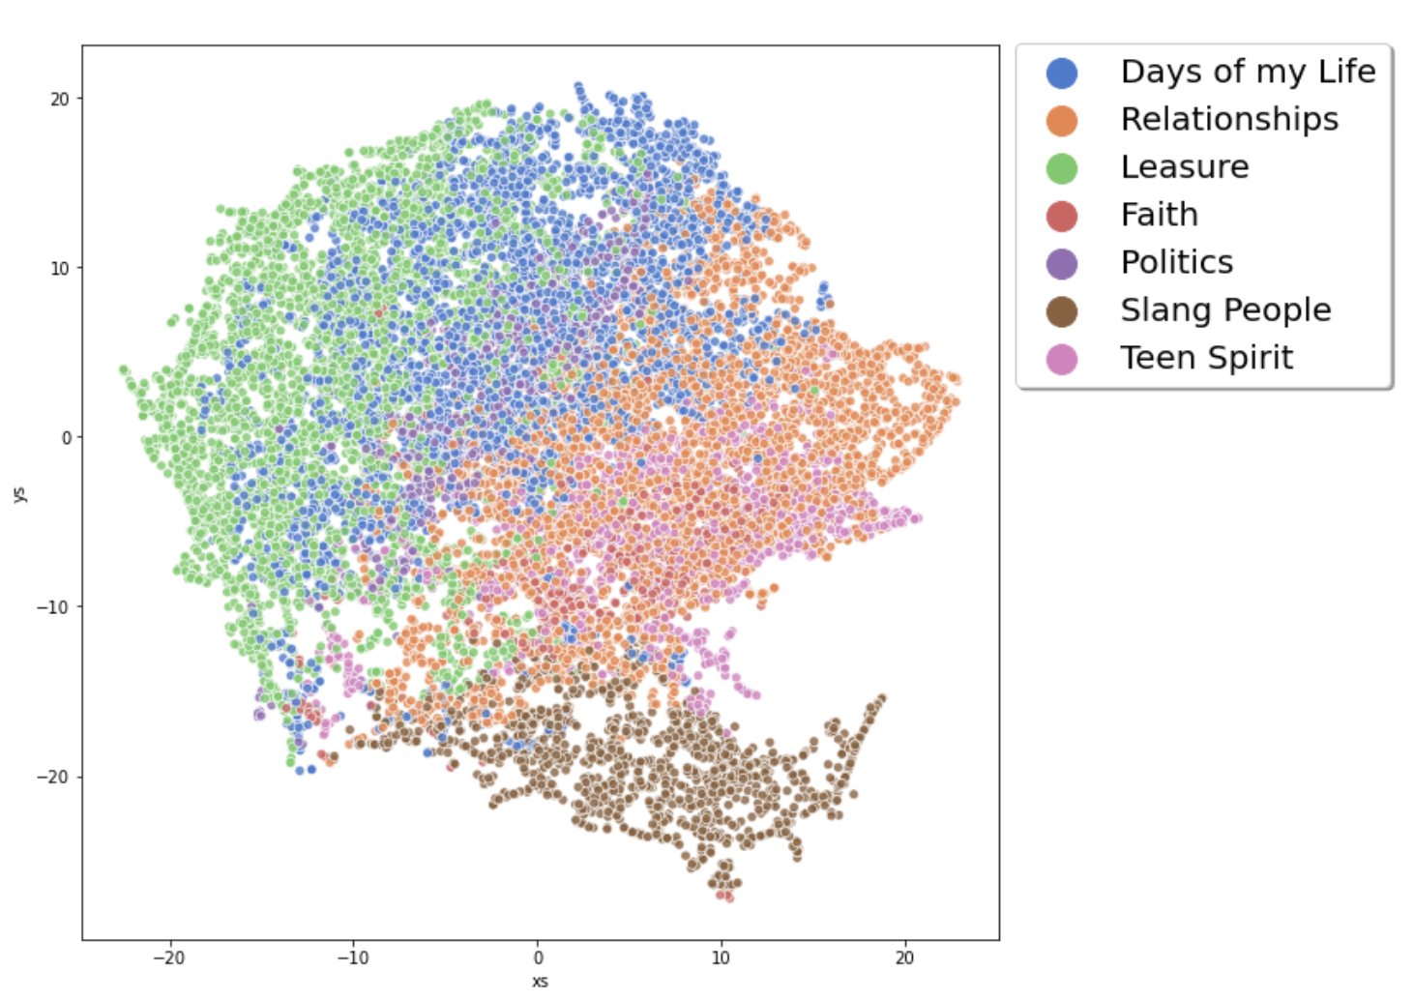
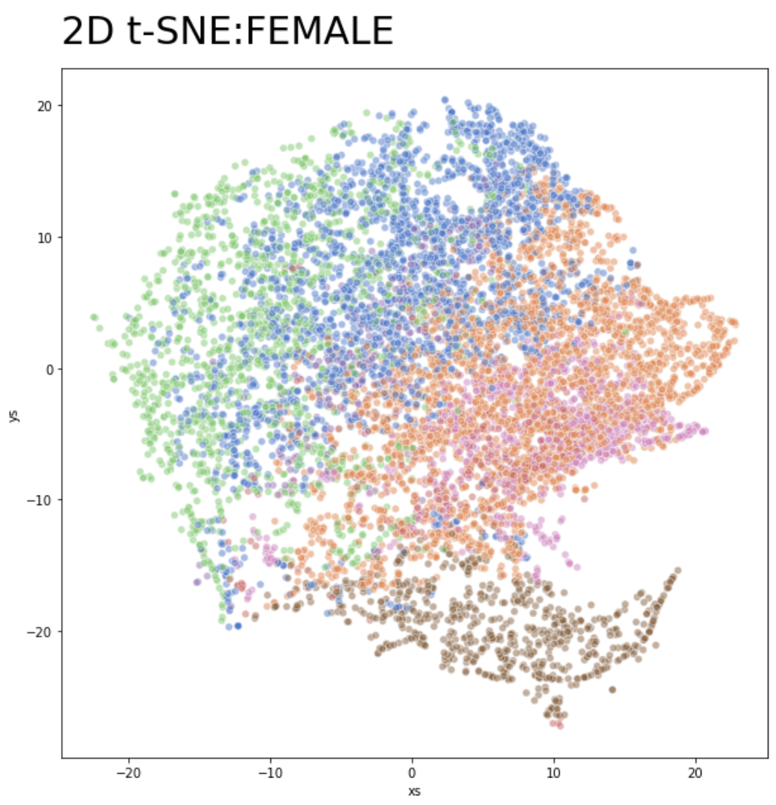
2D t-SNE BLOGGER.COM primary topics projection

Slide 10
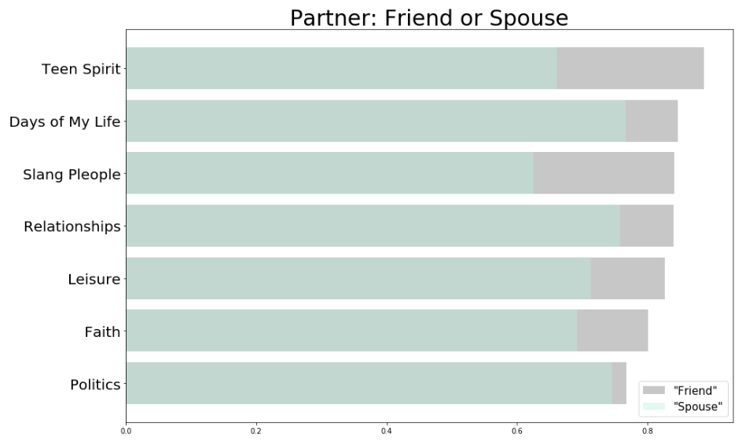
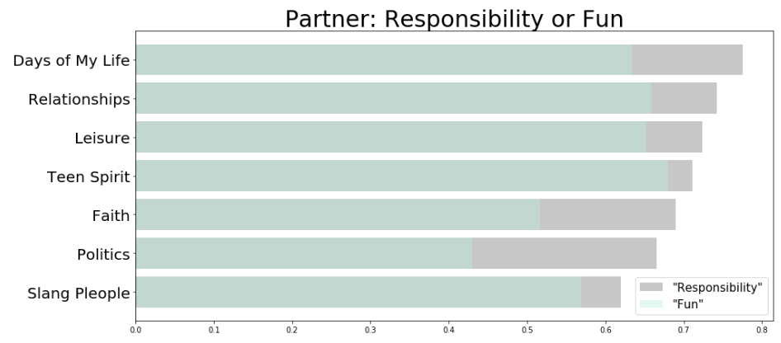
Semantics across communities
“partner”
﻿Days of My Life
spouse, husband, companion
Teen Spirit
parents, sibling, life
Relationships
spouse, girlfriend, wife
Slang People
girlfriend, boyfriend, supervisor
Politics
spouse, colleague, employer
Faith
family, mentor, equipping
Leisure
spouse, supervisor, teammate
Notes:
Here I investigate the context to infer word meaning across different communities clustered using topic modeling. To build word embeddings I leverage the distributional hypothesis word meaning can be understood from the neighboring words.

Slide 11
03
EMOTIONS OVER TIME

Slide 12
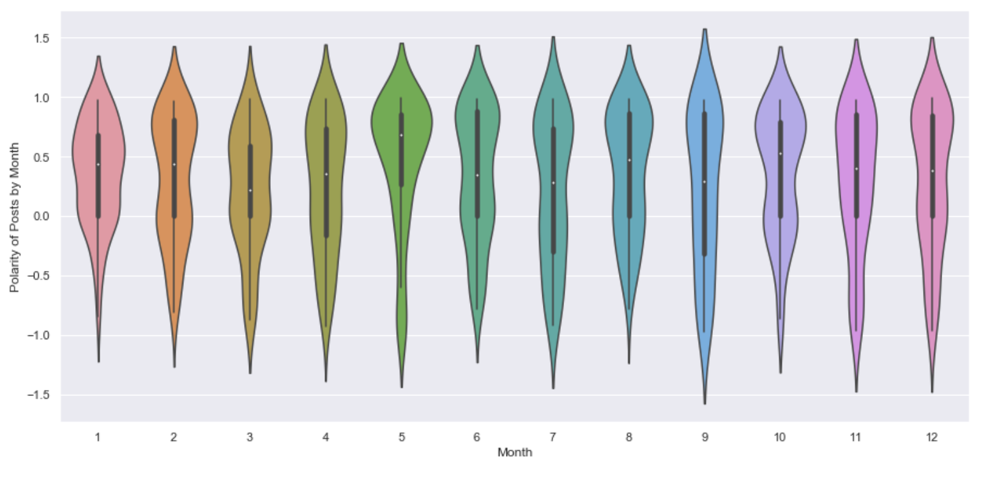

Slide 13
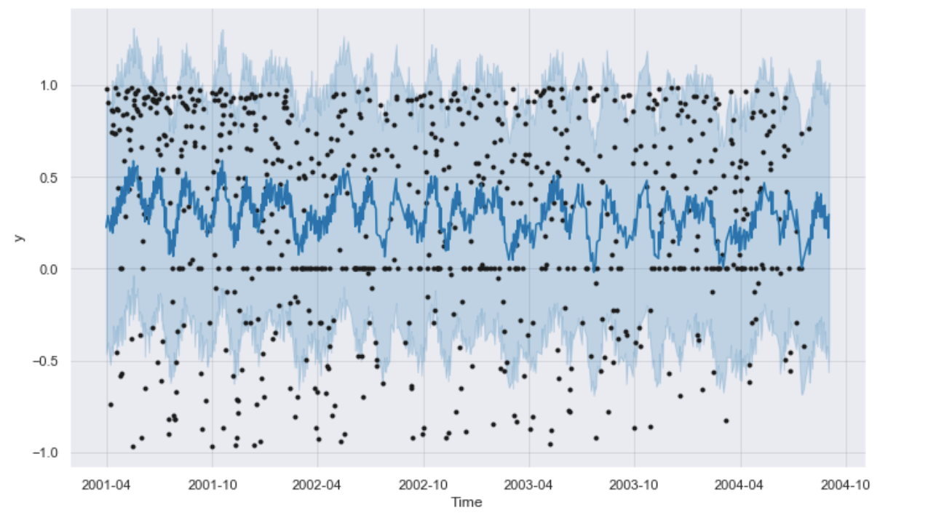

Slide 15
04
BLOGGER BOOSTER WEB APP

Slide 16
NOTE ON ETHICS
The application is meant to rise self-awareness, better understand flow of emotions, and help people identify themselves in the blogging community.
To be able to perform the analysis intimate thoughts, personal events and feelings are extracted.
Therefore it is imperative that data as well as the result of the analysis are confidential, owned by the user, and are never used for any purpose other than maintaining personal well-being.

Slide 17
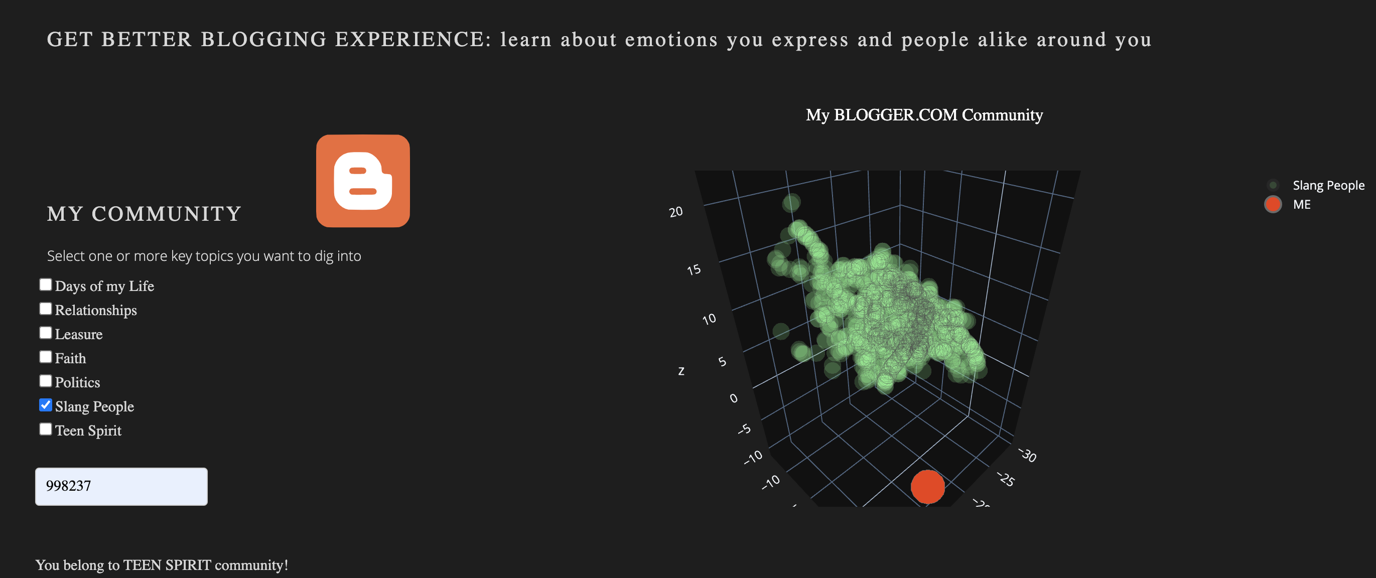
Community Visualizer

Slide 18
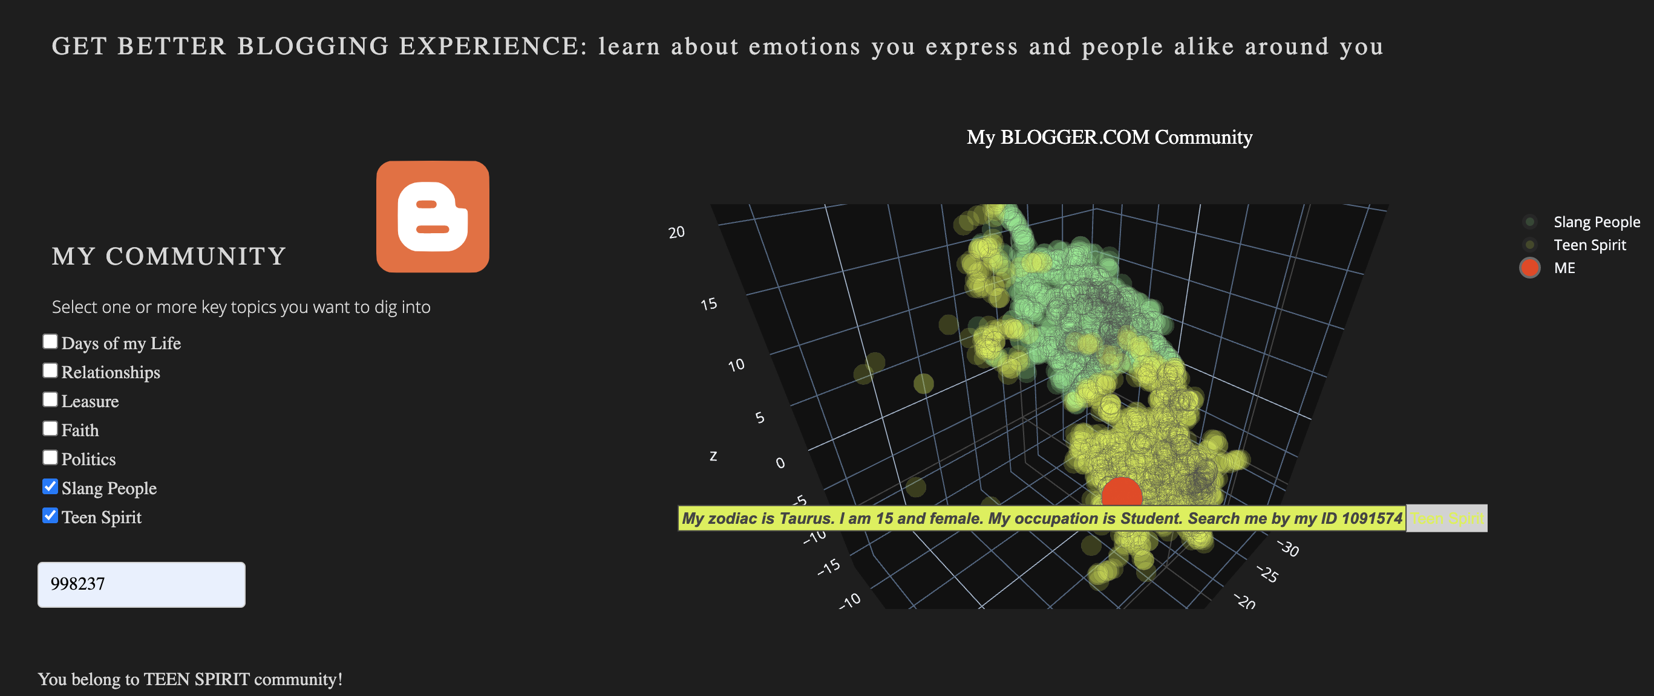
Community Visualizer

Slide 19
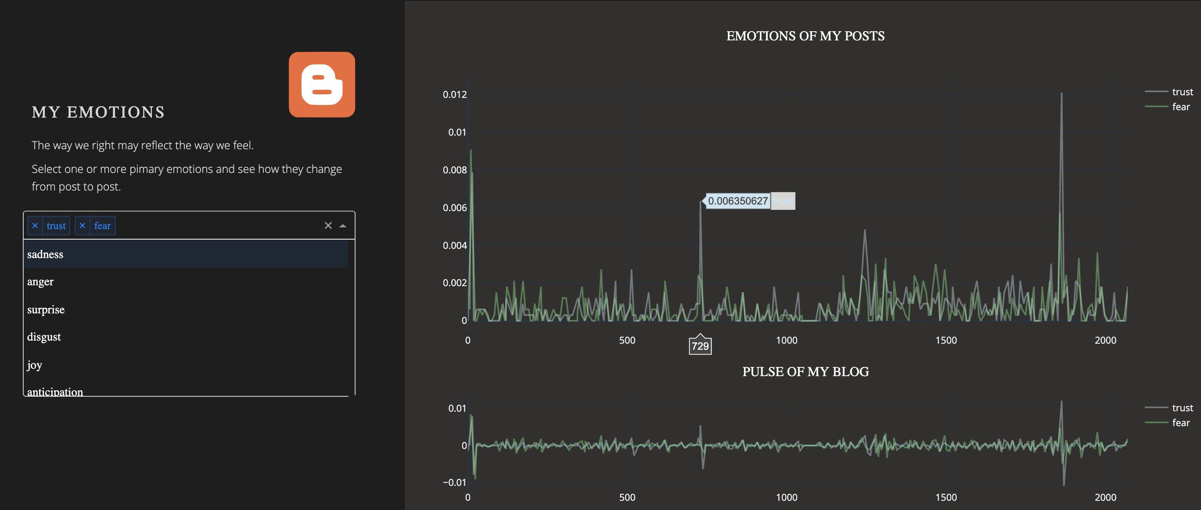
Emotional Profile

Slide 20
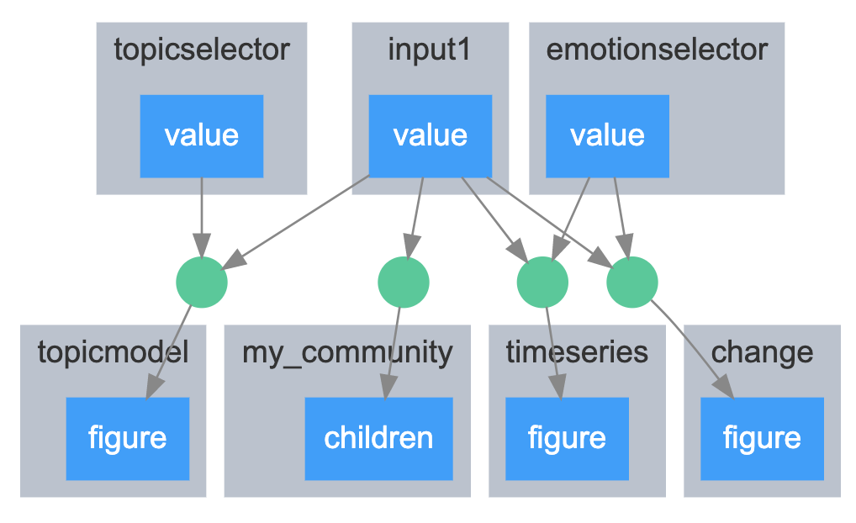
Conceptual Architecture

Slide 21
THANK YOU
do you have any questions?
email: elena@dubova.net
GitHub repo: https://github.com/elena-du/Blogger_Boost.git

